Slide 1
Rockingham County Comprehensive Transportation Plan (CTP) Survey Results
Pam Cook, Emily Stupka
August 6, 2024

Slide 2
Rockingham County CTP
Who Responded?
524 Responses
0.6% of the county population

Slide 3
Rockingham County CTP
Demographics: Gender
Survey Results vs Rockingham County 2022 OSBM Data

Slide 4
Rockingham County CTP
Demographics: Age
Survey Results vs Rockingham County 2022 OSBM Data

Slide 5
Rockingham County CTP
Demographics: Race & Ethnicity
Survey Results vs Rockingham County 2022 OSBM Data

Slide 6
Rockingham County CTP
Demographics: What Describes You?

Slide 7
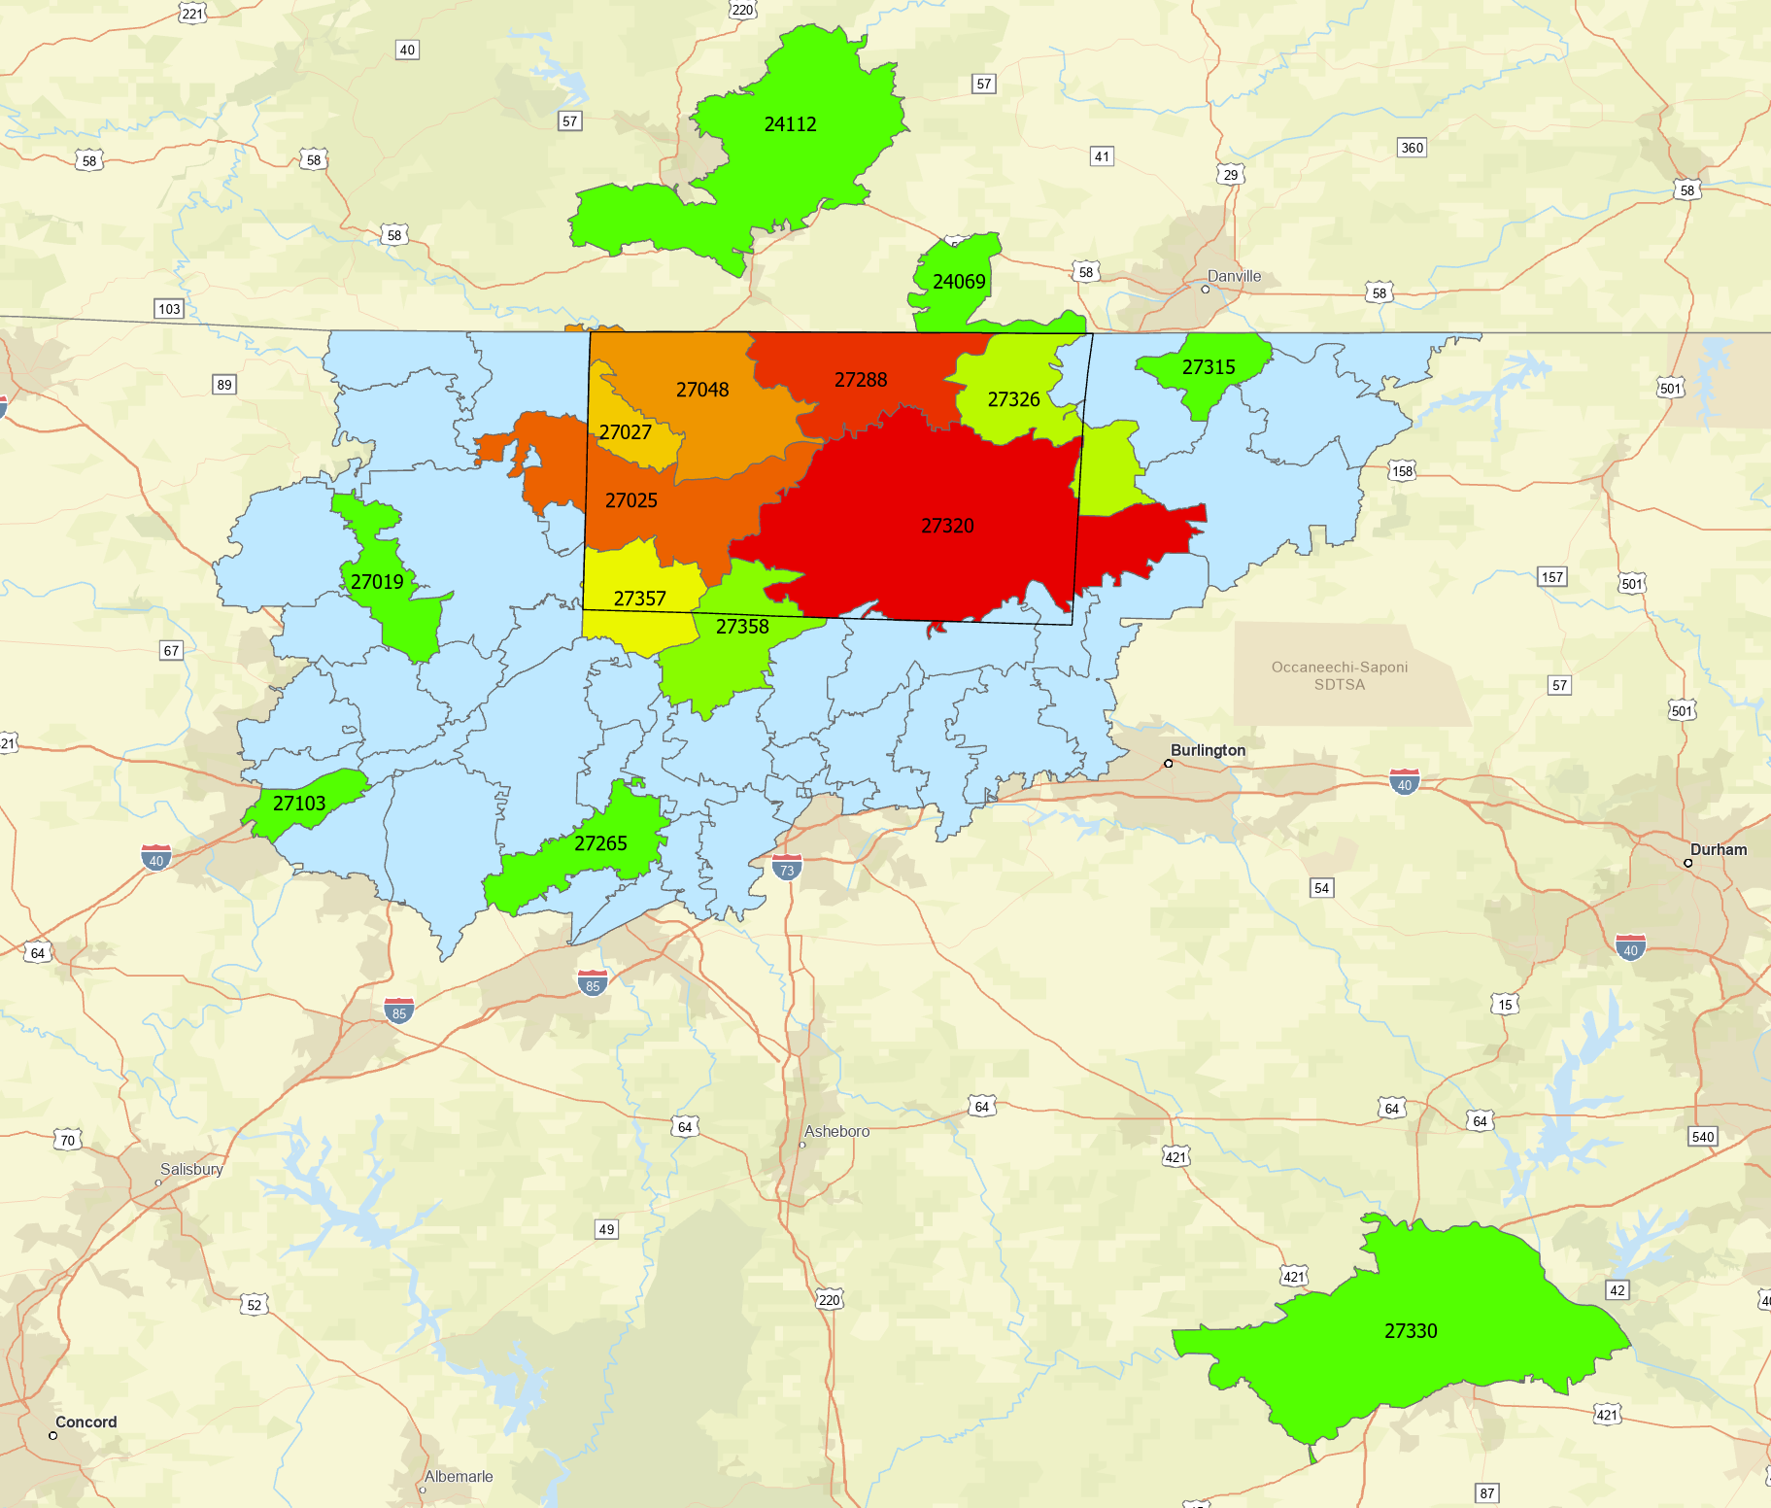
Rockingham County CTP
Demographics: Zip Codes
Green Red Increasing Participants from this Zip Code

Slide 8
Rockingham County CTP
Priority Ranking Results
Participants ranked their top priorities, with 1 being their highest priority.
Average Ranking: Times in Top 5:
Road Condition & Safety 2.48 282
Accessibility 2.76 254
Connectivity 2.81 246
Top 3
4. Environment 3.04 171
5. Community & Economy 3.11 234
Multi-Modal Options 3.20 138
Mobility 3.36 174
8. Future Technologies 3.52 96
Other Averages

Slide 9
Rockingham County CTP
Strategy Ratings Results: General
Participants rated each question, with 5 starts being strongly agree.
Question | Average Star Rating | Comment Summary (34)
Safety: It is a priority for residents to feel safe while using transportation options in Rockingham County. | 4.66* with 325 responses | Biking on the roads is not safe, so bike lanes and other facilities are needed. There is a need for a county-wide, reliable, and affordable public transportation system for all. There is a need for more sidewalks, especially on major roads. Safety for all users is very important. Investment into the community is needed. It is important to protect the environment and the beauty of the county. Completion of I-73 corridor would be helpful. There are safety concerns on Highway 135 at the rail crossing.
Accessibility: Transportation options should support people of all ages and abilities. | 4.60 with 319 responses
Environment: Transportation options should promote the preservation of natural resources, such as watersheds, nature preserves, lakes, and rivers. | 4.38 with 311 responses
Community Growth: Transportation options should support community growth and economic development. | 4.53 with 310 responses

Slide 10
Rockingham County CTP
Strategy Ratings Results: Roadway
Question | Average Star Rating | Comments Summary (30)
Maintenance: There should be a focus on maintaining existing roads before spending resources on other projects. | 4.34 with 294 responses | Widening needed for US 29 / I-785 and US 158. Connectivity and traffic are not current issues. Existing infrastructure should better support freight. Freight should not be traveling through downtowns. An east/west connection is needed. There needs to be a balance of new infrastructure and maintaining current infrastructure. Remaining gravel roads should be paved. Expressed support for round-abouts.
Traffic: It is important for travelers to get to their destinations quickly, and without traffic. | 4.02 with 288 responses
Connectivity: There should be more connections between towns, popular destinations, areas of employment, recreation, and medical facilities | 4.18 with 294 responses
Freight: It is important to improve truck routes to ensure efficient delivery of goods. | 4.10 with 290 responses

Slide 11
Rockingham County CTP
Strategy Ratings Results: Public Transit
Question | Average Star Rating | Comments Summary (16)
Local Expansion: Public transit options should be expanded to more locations within the county. | 4.23 with 270 responses | Support for connections to Greensboro. Better connections to medical facilities inside and outside of the county. Some comments against expansion of transit options. Better transit infrastructure (sidewalks, crosswalks/shelters) is needed.
Regional Expansion: Public transit options to nearby regions, like Greensboro, should be expanded. | 3.95 with 272 responses
Park and Ride Lots: There should be more designated areas to park vehicles or bikes to make it easier to use transit or carpool. | 3.92 with 273 responses
Availability: Hours of operation should be expanded for public transit. | 4.00 with 265 responses

Slide 12
Rockingham County CTP
Strategy Ratings Results: Biking
Question | Average Star Rating | Comments Summary (19)
Expand Biking: There should be more places to bike safely. | 4.04 with 270 responses | Bike lanes are needed. Bikes lanes are preferred in downtown areas and busy areas, while greenways are great for connecting further places. Scooter routes should be considered. Bikes should be protected by barriers from cars. Bike lane on the Highway 135 Bridge.
Bike Routes: There should be designated and signed bike routes. | 4.02 with 266 responses
Type: The transportation system should focus on off-road biking, like greenways, rather than bike lanes. | 3.83 with 269 responses

Slide 13
Rockingham County CTP
Strategy Ratings Results: Pedestrian
Question | Average Star Rating | Comments Summary (16)
Expansion: More sidewalks are needed. | 4.21 with 273 responses | More sidewalks around the Walmarts, and around Stadium Dr. Gaps need to be fixed in downtowns. Need to consider if there is enough traffic to justify cost of sidewalk. Focus sidewalk additions in areas around transit stops/users. Sidewalks needed in Madison and Mayodan, especially around schools and shopping. Sidewalks needed to connect Madison and Mayodan. Low-income areas would benefit greatly from sidewalks. Sidewalks needed along: Highway 135, Burton St in Madison, Highway 14, Van Buren.
Filling in Gaps: There should be a focus on filling in sidewalk gaps to improve connectivity and safety. | 4.23 with 276 responses

Slide 14
Rockingham County CTP
Map Markers
Number of markers by category
257
99
Highway, Congestion, & Accidents
Pedestrian
68
85
Biking
Public Transportation
49
13
Destinations
Other Comments

Slide 15
Rockingham County CTP
Map Markers
Roadway, Congestion, and Accidents 255 Markers with 118 comments
Category Breakdown
Access Control - 8
Bridge Improvements -2
Speed Limit Improvements - 8
Confusing Design - 4
Traffic Congestion – 13
Dangerous Roads – 12
Intersection Improvements - 17
Maintenance – 19
Modernization/Widening - 20
Other - 13
Comment Summary
NC 87
School traffic
General congestion
Intersection with NC 65 is confusing
Lights needed at NC 87 and US 29
US 29
U-Turns and left turns causing issues
Upgrade to interstate standards
NC 158
Needs more lanes
NC 704
Improve to interstate standards
NC 770
Traffic light syncing needed
Rough pavement on Mayo River Bridge
NC 14
Widen to VA
Repave
I 73
Complete upgrade
US 29 BUS
Bad conditions, potholes
Design is confusing at NC 158
US 311
Needs widening to VA
Intersection w/ Arbor needs redesigned
US 220
Issues with standing water
Improve intersection with NC 31
Improve on/off ramps
NC 135
Many accidents
Roundabout wanted at River Rd

Slide 16
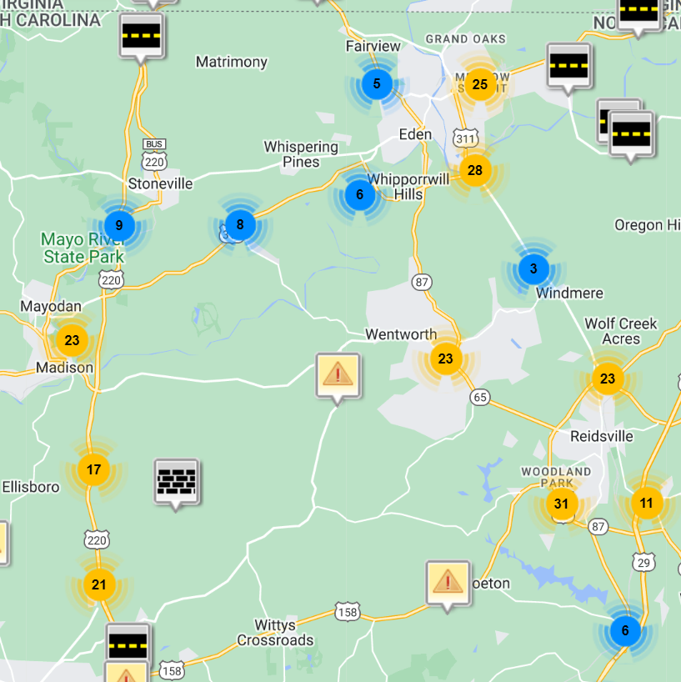
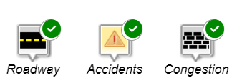
Rockingham County CTP
Map Markers
Roadway, Congestion, and Accidents

Slide 17
Rockingham County CTP
Map Markers
Public Transportation 85 Markers with 43 comments
Category Breakdown
Transit Stop Needed – 6
Better infrastructure (lanes, shelters) – 2
Improve scheduling – 2
More routes in general – 5
More routes for medical care - 6
Desire for trains – 3
Focus on rural connectivity - 6
Other - 13
Comment Summary
Transit Stops
RCC
MMRC
Mayo River State Park
Improve bus stops for safety and congestion
Not enough routes or availability in general
More routes for medical care and appointments, including to Greensboro
Train between Eden, Wentworth, and Reidsville

Slide 18
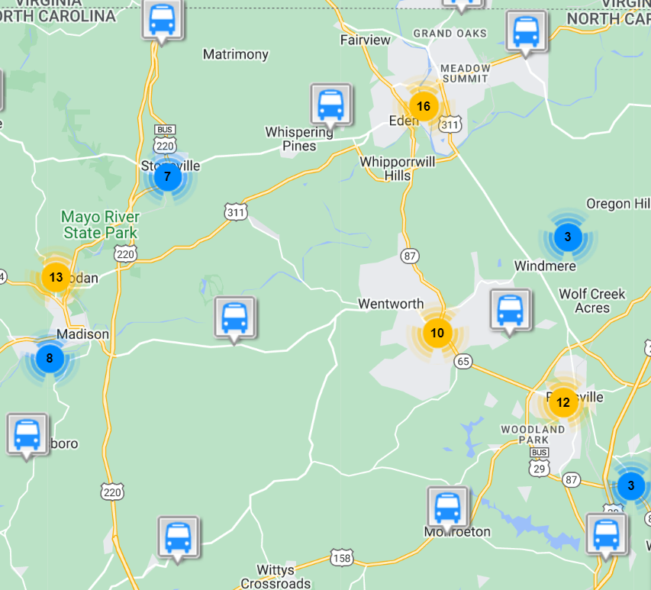
Rockingham County CTP
Map Markers
Public Transportation

Slide 19
Rockingham County CTP
Map Markers
Bicycles 68 Markers with 36 comments
Category Breakdown
Bike Lane Needed - 17
Greenways & Trails - 8
Safety Concerns - 8
Other - 3
Comment Summary
Eden
Need bike lanes
Old State Hwy 87, W Kings Hwy, N Van Buren Rd, Church St, NC 14
Walmart area to Draper High School
More greenways, especially along Dan River in Eden
Reidsville
Need bike lanes
Around South End Elementary School and Lower Jaycee Park
Need Greenways, specifically
More around Sherwood Trail & to Lake Reidsville
Wentworth
Need bike lanes on NC 87 and NC 65, around RCC
Stoneville
Bike lanes to Mayo River State Park and on Settle Bridge Rd
Need greenways
Madison & Mayodan
Bike lanes or greenways to connect towns and Madison River Park
General safety concerns about biking in downtowns

Slide 20
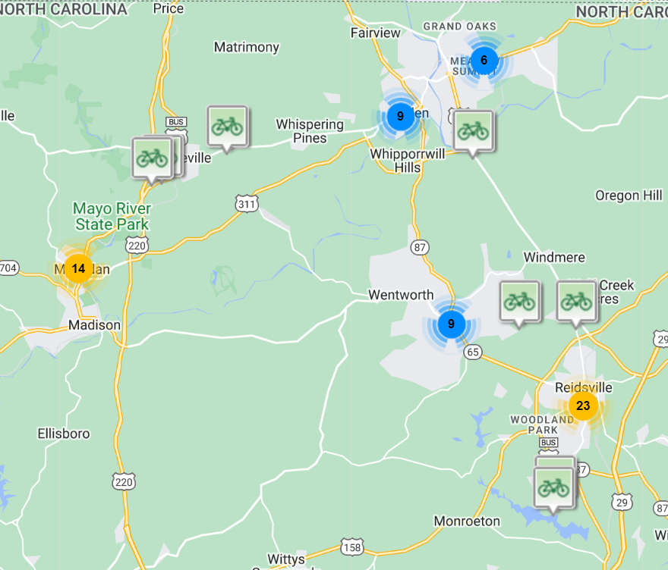
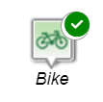
Rockingham County CTP
Map Markers
Biking

Slide 21
Rockingham County CTP
Map Markers
Pedestrian 99 Markers with 48 comments
Category Breakdown
Sidewalk Needed - 31
Crosswalk Needed - 1
Greenway Needed - 8
Gaps in sidewalk - 3
Speeding in pedestrian areas - 2
Other - 3
Comment Summary
Eden
Need sidewalks
Country Club Dr, Van Buren Rd, W Meadow Rd, Old 87, Church St, S Hamilton
Throughout Downtown
More greenways along Smith River, Dan River, and Matrimony Creek
Speeding on Country Club Dr needs to be addressed
Reidsville
Need sidewalks
Downtown, W Harrison, US 29Bus, NC 65, S Scales St, Maple Ave, Belmont Dr
Need Greenways to Lake Reidsville
Wentworth
Need sidewalks on NC 87, NC 65, Country Home
Stoneville
Sidewalks to MRSP
Madison & Mayodan
More sidewalks in both downtowns and between downtowns
Sidewalks need on Hwy St, US 311, NC 135
Greenways and connections along Mayo River to MRSP

Slide 22
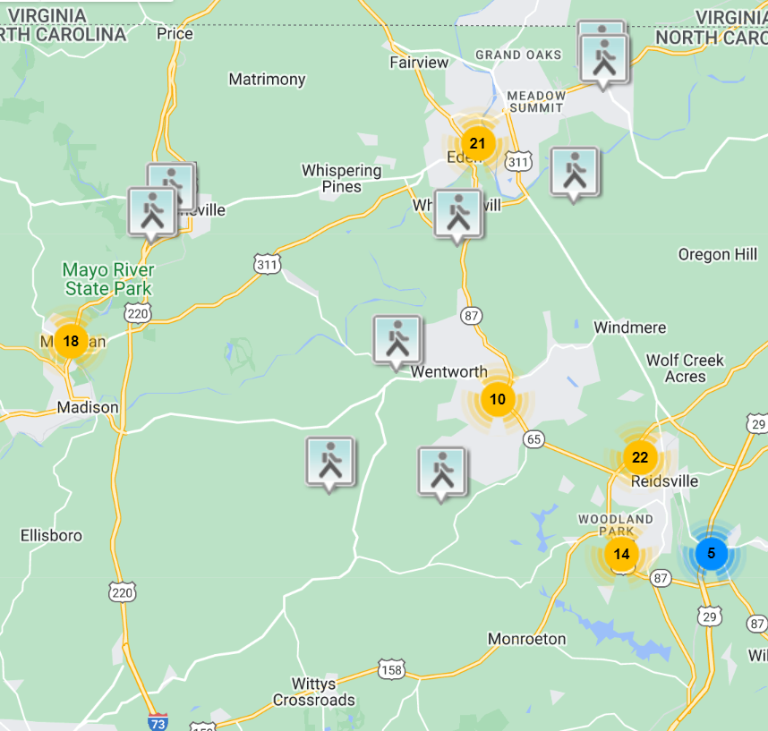
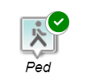
Rockingham County CTP
Map Markers
Pedestrian

Slide 23
Rockingham County CTP
Map Markers
Destinations 49 Markers with 30 comments
Destinations
Albaad USA *
Ashcroft Commons *
Bradford Pkwy in Greensboro *
Dan River - 4
Dan River Access Boat Launch
Eden
Greensboro
Greyhound Greensboro Bus Stop *
Jacobs Creek Batteau Landing*
Jaycee Park
King Memorial Baptist Church*
Lake Hunt - 2
Lake Reidsville
Lynrock Golf Club*
Madison/Mayodan - 3
Madison/Mayodan Rec Center
Mayo River - 2
Possible Casino *
Reidsville - 2
Reidsville Housing Authority *
Reidsville Lake
Rockingham CC Satellite Campus*
Smith River*
Stokesdale*
Stoneville - 3
Swifty's Auto Detailing – 2*
The Increase Learning Center Inc*
Tractor Supply (Eden)*
US 29 exit 150*
Wentworth - 4
* denotes destinations not on our existing key destination list.

Slide 24
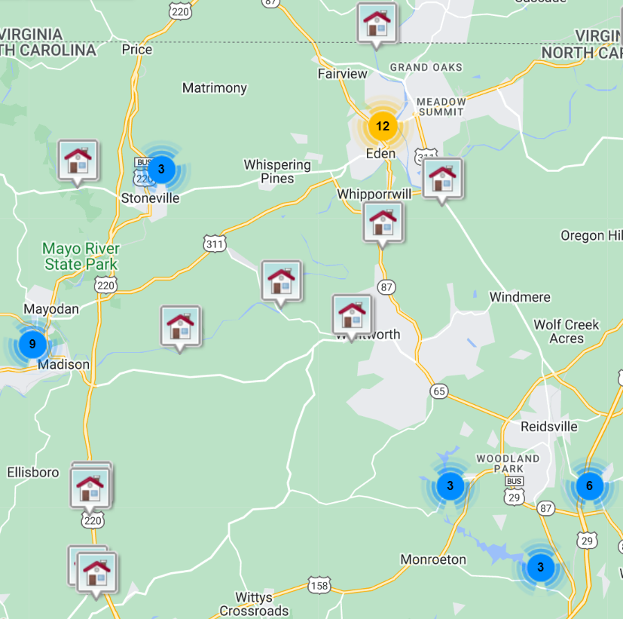
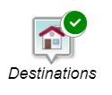
Rockingham County CTP
Map Markers
Destinations

Slide 25
Rockingham County CTP
Map Markers
Other 12 comments
Comment Summary:
Penrose Mall area is confusing.
The drive to Madison from Huntsville Elementary is stressful – a bridge somewhere could be nice.
Check condition of the S Henry St train trestle.
More consistent speed limits in Madison/ Mayodan.
Improve attractive landscaping throughout County.
NC 135 rail crossings interfering with emergency response vehicles and is dangerous.

Slide 26
Draft Vision
Rockingham County CTP
Draft Vision
Rockingham County has a safe, well-maintained, accessible, efficient, and convenient multi-modal transportation system that removes barriers while connecting its residents and visitors of all ages and abilities to their destinations within the county and regionally that minimizes impacts to the natural environment and supports economic and community growth.

Slide 27
Draft Goals and Objectives
Rockingham County CTP
Draft Goals and Objectives
The roads in Rockingham County are well-maintained.
Objective: Encourage state-maintained roads instead of locally maintained roads (Rockingham County currently has XXXX miles of locally maintained roads).
Traveling to destinations and between destinations in Rockingham County is efficient and convenient.
Rockingham County is destination focused, considering development of access to destinations as roads are improved and new development is built.
Objective: Roads between municipalities, outdoor destinations, and other key destinations are comfortable to drive, with sufficient lane width, and paved shoulders at a minimum.
There are designated and marked bike routes with signage.
Recreational areas throughout the county are accessible by all modes.
There is a signage system that guides residents and visitors to key recreational areas throughout the county.
Area maps identify recreational areas.

Slide 28
Draft Goals and Objectives
Rockingham County CTP
Draft Goals and Objectives
3. Rockingham County has a safe and accessible multi-modal transportation system.
There are safe facilities for vehicles, pedestrians, and bicyclists.
Residents have access to public transportation.
There is an on-demand public transportation system.
Facilities support pedestrians and bicyclists.
Sidewalks and Greenways meet ADA requirements.
Connected sidewalks and greenways without gaps.
Increase existing connectivity by filling in gaps.
Incorporate complete streets where possible.
Complete streets is a policy and design approach that considers bikes, pedestrians, public transportation, and vehicles.
4. Protection of existing watersheds is a priority.
Encourage cluster development within the watershed (area of land that drains water into a waterbody).
Reduce lot sizes and setbacks to promote conservation of open space.
Minimize stream buffer impacts.

Slide 29
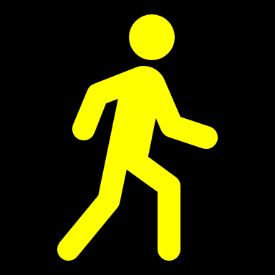
Rockingham County CTP
----------------------------------- Questions?-------------------------------------------

